Slide 1
Rule-Based Modeling with BioNetGen
Jim Faeder
Jose Juan Tapia
Bobby Sheehan
Department of Computational and Systems Biology
University of Pittsburgh School of Medicine

Slide 2
Outline
Introduction to rule-based modeling
Essentials
Specifying a model
Simulating a model
Hands on tutorial (optional)
For additional information and references see http://bionetgen.org/index.php/q-bio-14

Slide 3
Introduction

Slide 4
Early events in FcεRI signaling

Slide 5
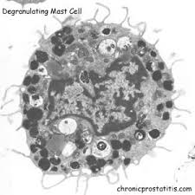
Challenges for Modeling
Large number of components and interactions
Rapidly evolving list of important components and interactions
structural uncertainty in the model
Involvement of multiple processes
signaling
gene regulation
protein expression
(cell division)
Gilfillan and Tkaczyk (2006) Nat. Rev. Immunol.

Slide 6
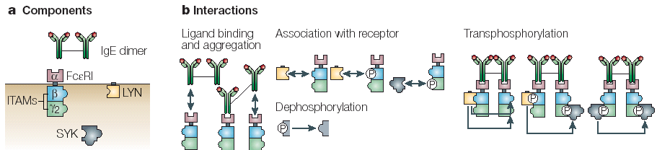
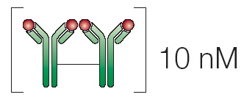
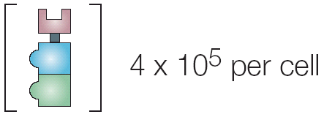
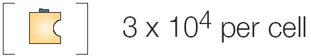
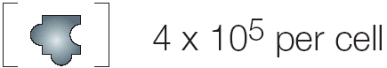
Rule-Based Modeling protocol
1. Identify components and interactions
2. Translate into objects (molecules) and rules
…
…
3. Determine concentrations and rate constants
4. Simulate and analyze the model
ODE’s
SSA
PDE’s
BD

Slide 7
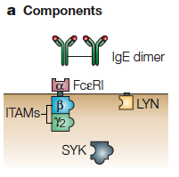
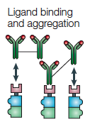
Rule-Based Modeling with BioNetGen
Molecules are structured objects
IgE(a,a)
FceRI(a,b~U~P,g2~U~P)
Lyn(U,SH2)
Syk(tSH2,lY~U~P,aY~U~P)
Advantages
Retain detailed information about molecular interactions.
Scalable both in model construction and simulation.
Components represent sites of binding and postranslational modification
Rules govern their interactions
IgE(a,a)+ FceRI(a)<-> IgE(a,a!1).FceRI(a!1)
Because rules act locally they may generate many possible reactions

Slide 8
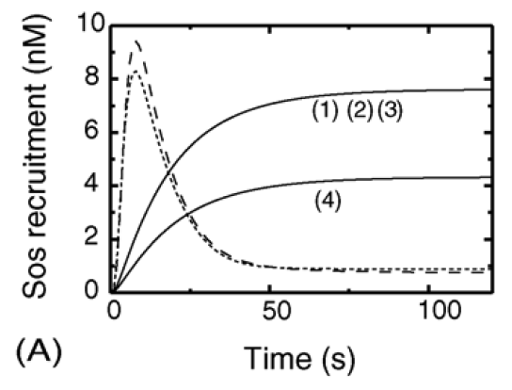
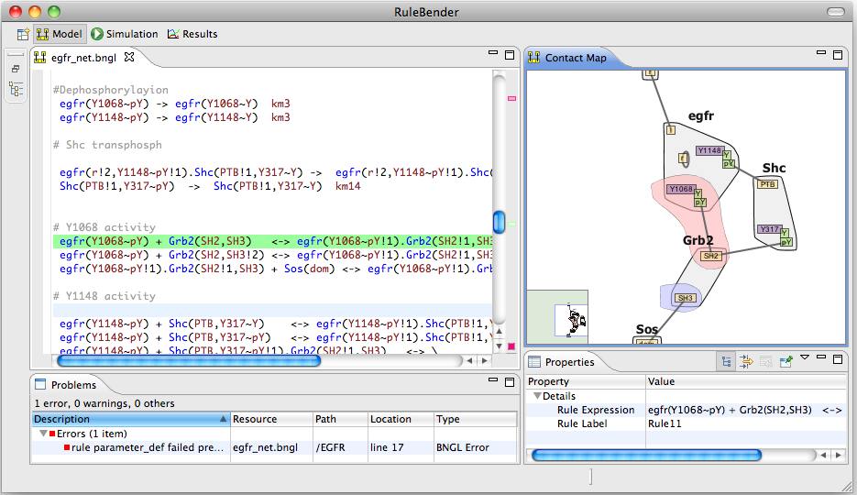
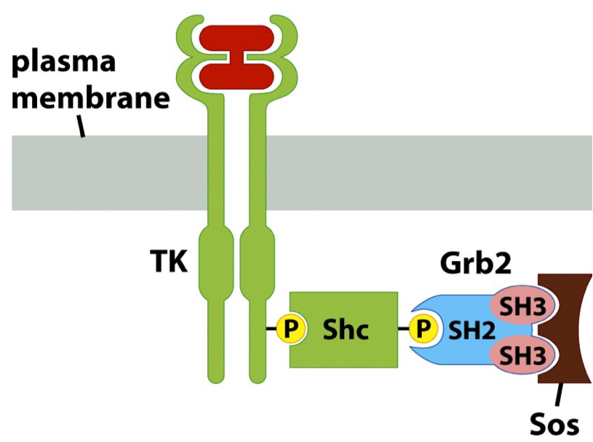
Basic RBM workflow with BioNetGen
RuleBender GUI
http://bionetgen.org
http://rulebender.org
http://nfsim.org

Slide 9
One language to rule them all*
SBML
Matlab
Virtual Cell
PDEs
BNGL
BioNetGen
Reaction Network
CVODE
Output
SSA (Gillespie)
PLA (τ-leap)
MCell
Brownian dynamics
NFsim
RuleMonkey
rejection-free network free
pySB
SRsim
Brownian dynamics + mol. structure
*Just kidding

Slide 10
Overall Modeling Workflow
Detailed signaling biochemistry can be directly encoded as a rule-based model (RBM).
Parameter estimation to fit experimental data
Efficient simulation of RBM’s using direct or indirect methods

Slide 11
Specifying a rule-based model

Slide 12
Defining Molecules
Molecules are the basic objects in a BNG model
BioNetGen Language
IgE(a,a)
FceRI(a,b~U~P,g2~U~P)
Lyn(U,SH2)
Syk(tSH2,lY~U~P,aY~U~P)
Components represent molecule elements
Domains
Motifs
Properties
Notes:
Start here – more or less.

Slide 13
Defining Molecules
Molecules are the basic objects in a BNG model
BioNetGen Language
IgE(a,a)
FceRI(a,b~U~P,g2~U~P)
Lyn(U,SH2)
Syk(tSH2,lY~U~P,aY~U~P)
Components may have different states representing
posttranslational modifications
conformational state
…
Notes:
Start here – more or less.

Slide 14
Binding
Molecules bind other molecules through components
BioNetGen Language
IgE(a,a!1).FceRI(a!1,b~U,g2~U)
Bonds are formed by linking two components. The ‘.’ indicates a set of molecules forming a complex.
Components may have both states and bonds.
Bonds may occur within a molecule.
FceRI(a,b~U!1,g2~U).Lyn(U!1)
Lyn(SH2!1,Cterm~P!1)
Notes:
Start here – more or less.

Slide 15
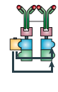
Defining Interaction Rules
BioNetGen Language
IgE(a,a)+ FceRI(a)<-> IgE(a,a!1).FceRI(a!1)
…
binding and dissociation
Transphosphorylation
Lyn(U!1).FceRI(b!1).FceRI(b~U)-> \
Lyn(U!1).FceRI(b!1).FceRI(b~P)
component state change

Slide 16
Parts of a rule
Reactants
Arrow
Products
Rate Law
IgE(a,a)+ FceRI(a)<-> IgE(a,a!1).FceRI(a!1) kp1, km1

Slide 17
Parts of a rule
Reactants
Arrow
Products
Rate Law
IgE(a,a)+ FceRI(a)<-> IgE(a,a!1).FceRI(a!1) kp1, km1
IgE(a,a)
FceRI(a,b~U,g~U)
Reactant patterns select properties of each reactant molecule.

Slide 18
Parts of a rule
Reactants
Arrow
Products
Rate Law
IgE(a,a)+ FceRI(a)<-> IgE(a,a!1).FceRI(a!1) kp1, km1
IgE(a,a)
FceRI(a,b~U,g~U)
States of components not specified don’t affect the match.
“Don’t write, don’t care.”
FceRI(a,b~P,g~U)
Reactant patterns select properties of each reactant molecule.

Slide 19
Parts of a rule
Reactants
Arrow
Products
Rate Law
IgE(a,a)+ FceRI(a)<-> IgE(a,a!1).FceRI(a!1) kp1, km1
IgE(a,a)+ FceRI(a,b~U,g~U)<-> IgE(a,a!1).FceRI(a!1,b~U,g~U) kp1, km1
IgE(a,a)+ FceRI(a,b~P,g~U)<-> IgE(a,a!1).FceRI(a!1,b~P,g~U) kp1, km1
Reactant patterns select properties of each reactant molecule.
Because patterns can match many different species, each rule can generate many reactions.

Slide 20
Center and context
The center of a rule is the part that the rule changes.
bond is formed
IgE(a,a)+ FceRI(a)<-> IgE(a,a!1).FceRI(a!1) kp1, km1
The context is the part that is necessary for the rule to happen but is unchanged.

Slide 21
Center and context
The center of a rule is the part that the rule changes.
bond is formed
IgE(a,a)+ FceRI(a)<-> IgE(a,a!1).FceRI(a!1) kp1, km1
The context is the part that is necessary for the rule to happen but is unchanged.
Transphosphorylation
Context can represent complex biochemistry.
component state is changed
Lyn(U!1).FceRI(b!1).FceRI(b~U)-> \
Lyn(U!1).FceRI(b!1).FceRI(b~P)

Slide 22
Composition of a Rule-Based Model
Molecules
Reaction Rules
BioNetGen language
begin molecules
Lig(l,l)
Lyn(U,SH2)
Syk(tSH2,l~U~P,a~U~P)
Rec(a,b~U~P,g~U~P)
end molecules
begin reaction_rules
# Ligand-receptor binding
1 Rec(a) + Lig(l,l) <-> Rec(a!1).Lig(l!1,l) kp1, km1
Rec(a) + Lig(l,l) <-> Rec(a!1).Lig(l!1,l) kp1, km1
# Receptor-aggregation
2 Rec(a) + Lig(l,l!1) <-> Rec(a!2).Lig(l!2,l!1) kp2,km2
# Constitutive Lyn-receptor binding
3 Rec(b~Y) + Lyn(U,SH2) <-> Rec(b~Y!1).Lyn(U!1,SH2) kpL, kmL
…

Slide 23
simulating a rule-based model

Slide 24
Automatic Network Generation
FcεRI Model
Seed Species (4)
(IgE)₂
Lyn
Syk
FcεRI
Reaction Rules (19)
Network
Network
New Reactions & Species

Slide 25
Automatic Network Generation
FcεRI Model
Seed Species (4)
(IgE)₂
Lyn
Syk
FcεRI
Reaction Rules (19)
354 Species
3680 Reactions

Slide 26
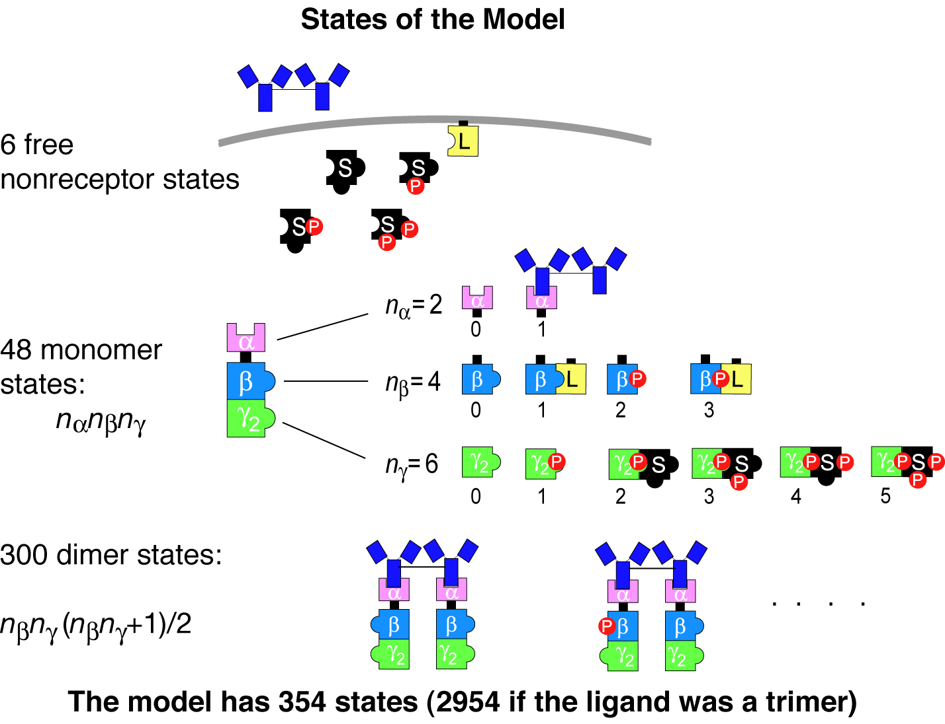
Combinatorial complexity

Slide 27
Addressing combinatorial complexity
354 species / 3680 reactions
Standard approach – writing equations by hand – won’t work!
New approach
Write model by describing interactions.
Automatically generate the equations.

Slide 28
Limits of Network Generation
Combinatorial complexity leads to exponential growth of reaction network size
Models with 10⁴-10⁵ reactions can easily arise.
For such large models, ODE simulation may become inefficient.
Simulations may have impractical CPU and/or memory requirements.

Slide 29
Nfsim*
Network-Free Stochastic Simulator
Generalization of rule-based kMC method of Yang et al.
Uses Gillespie (direct) algorithm to sample over reaction rules.
Like BKL ‘n-fold method’:
sites are instantiated
rule-based
transformations may affect reactivity of other sites in a complex.
Sneddon et al. (2011) Nat. Methods, 8, 177
http://emonet.biology.yale.edu/nfsim/

Slide 30
Network Free (NF) Algorithm
0. Initialize reactant lists and calculate rule propensities.
Select next reaction time and next rule.
Select molecules and sites to react.
Check any application condition(s).
Apply operation specified by rule.
Update reactant lists and propensities.
Increment time.
0 s⁻¹
15 s⁻¹
0.1 s⁻¹
Yang et al. (2008) Phys. Rev. E.

Slide 31
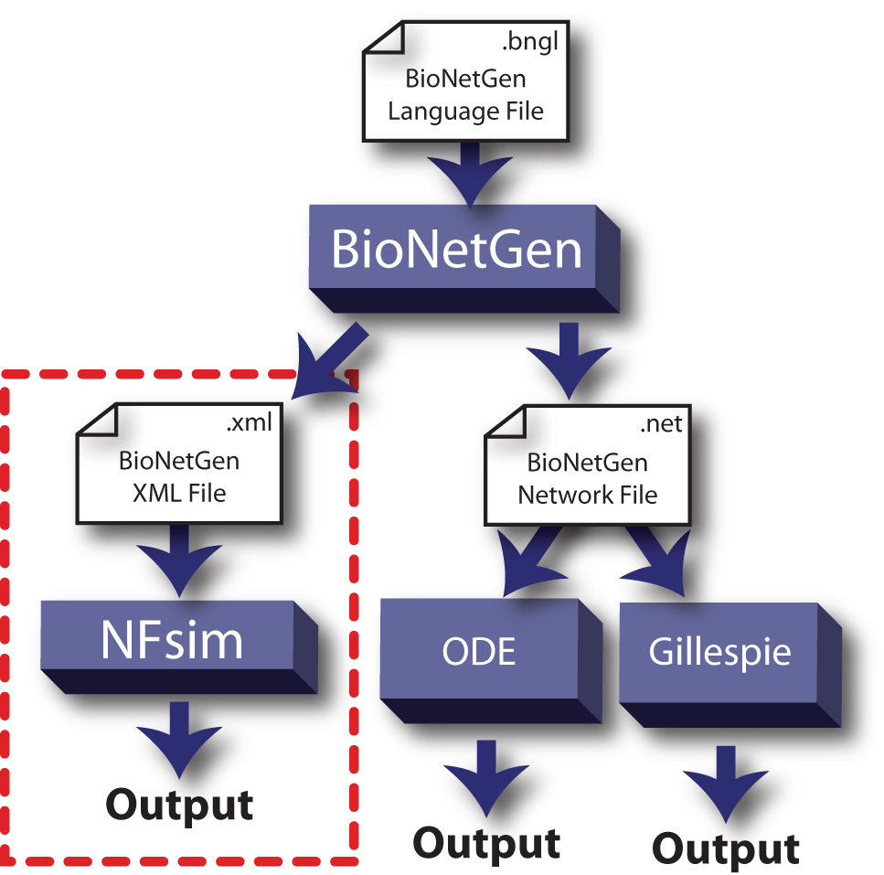
Integration with BioNetGen
OTF

Slide 32
FcεRI signaling models
NFsim can simulate models of greatly increased complexity with manageable increase in cost.
Increasing complexity
Sneddon et al. (2011) Nat. Methods, 8, 177

Slide 33
Large Scale TCR Signaling Model
Chylek, Hu, & Hlavacek

Slide 34
Large-scale RBM Studies
Interactome
Deeds et al. (2010?)
Yeast Pheromone
Thomson et al.
Tiger et al.
Deeds lab
Bacterial chemotaxis
Emonet lab
EGFR
Creamer et al. (2012)
TCR
Chylek et al. (2014)

Slide 35
Some Rule-Based Modeling Tools
Well-mixed / Compartmental Systems
BioNetGen / RuleBender / NFsim
Kappa
Spatially-resolved Systems
MCell
Simmune
Smoldyn / Moleculizer
BioNetGen@Virtual Cell
Stochastic Simulation Compiler
SRsim
ML-rules / ML-space
Meredys
Modeling Frameworks
pySB (see tutorial by Carlos Lopez)
rxncon
LBS (Language for Biological Systems)
Notes:
Table for comparison – check Lily and Bill’s review.

Slide 36
Recent BNG-related development
See http://bionetgen.org for more details.
Modeling resources
BioNetGen wiki
Mast cell modeling library (Chylek et al. 2014)
RuleHub (Tapia and Faeder, q-bio 2014)
Compartmental modeling (core)
Different spatial domains are treated as well-mixed compartments (Harris et al. 2009)
Model export (core)
Matlab: M-file / Mex-file
SBML (including compartments)
SSC (spatial stochastic simulator)
MCell (native MDL format)
Smoldyn (externally developed)
SBML Multi – under development
Import
SBML/BioModels
Atomizer - extract molecules / components from any SBML file (Tapia and Faeder 2013)
Hybrid simulation
Mix populations and agents (core / NFsim) (Hogg et al. 2014)
Accelerated stochastic simulations
Partitioned leaping algorithm (core) (Harris and Clancy 2006)
Rare event sampling
Weighted Ensemble (Donovan et al. 2014)
Visualization
Extended contact maps (Chylek et al. 2011)
Contact and process maps (core BNG)
Energy-based modeling (eBNGL)
Compact model description – interactions and cooperativity (Hogg 2013)
Parameter estimation
Ptempest (http://code.google.com/p/ptempest)
Boolean modeling
3 different Boolean update schemes (http://code.google.com/p/bionetgen/boolean)

Slide 37
References
L. A. Chylek, D. A. Holowka, B. A. Baird, and W. S. Hlavacek (2014) “An interaction library for the FcεRI signaling network,” Frontiers Immunol., 42pp.
L. A. Chylek, B. Hu, M. L. Blinov, T. Emonet, J. R. Faeder, B. Goldstein, R. N. Gutenkunst, J. M. Haugh, T. Lipniacki, R. G. Posner, J. Yang, and W. S. Hlavacek (2011) “Guidelines for visualizing and annotating rule-based models.,” Mol. Biosyst., 7, 2779–2795.
L. A. Chylek, L. A. Harris, C.-S. Tung, J. R. Faeder, C. F. Lopez, and W. S. Hlavacek (2013) “Rule-based modeling: a computational approach for studying biomolecular site dynamics in cell signaling systems.,” Wiley Interdiscip. Rev. Syst. Biol. Med., 6, 13–36.
R. M. Donovan, A. J. Sedgewick, J. R. Faeder, and D. M. Zuckerman (2013) “Efficient Stochastic Simulation of Chemical Kinetics Networks using a Weighted Ensemble of Trajectories.” J. Chem. Phys., 139, 115105.
Harris LA, Clancy P (2006) “A ‘partitioned leaping’ approach for multiscale modeling of chemical reaction dynamics.” J. Chem. Phys., 125, 144107.
L. A. Harris, J. S. Hogg, and J. R. Faeder (2009) “Compartmental rule-based modeling of biochemical systems,” in Proceedings of the 2009 Winter Simulation Conference (WSC09), pp. 908–919.
J. S. Hogg (2013) Advances in Rule-Based Modeling: Compartments, Energy, and Hybrid Simulation, with Application to Sepsis and Cell Signaling, PhD Thesis, University of Pittsburgh School of Medicine.
J. S. Hogg, L. A Harris, L. J. Stover, N. S. Nair, and J. R. Faeder (2014) “Exact hybrid particle/population simulation of rule-based models of biochemical systems.,” PLOS Comput. Biol., 10, e1003544.
J. J. Tapia and J. R. Faeder (2013) “The Atomizer: Extracting Implicit Molecular Structure from Reaction Network Models,” in Proceedings of the International Conference on Bioinformatics, Computational Biology and Biomedical Informatics (BCB’13), pp. 726–727.

Slide 38
Hands-on Tutorial

Slide 39
Technical Overview of the BioNetGen Language
parameters
molecule types
seed species
observables
functions
reaction rules
actions
BNGL file

Slide 40
Example 1: MM Mechanism
parameters
molecule types
seed species
observables
functions
reaction rules
actions
A BioNetGen model consists of a set of blocks, each beginning and ending with begin <blockname> / end <blockname> respectively.

Slide 41
Example 1: MM Mechanism
parameters
molecule types
seed species
observables
functions
reaction rules
actions
parameters – model constants are defined here. The user is responsible for using a consistent set of units, which should be indicated in the associated comments.

Slide 42
Example 1: MM Mechanism
parameters
molecule types
seed species
observables
functions
reaction rules
actions
begin parameters
# Avogadro's number- scaled for umol
NA 6.02e23/1e6
# Cell volume
V 1e-12 # liters - typical for eukaryote
# Rate constants
kp1 1.0/(NA*V) # 1/uM 1/s-> 1/molec 1/s
km1 1.0e-1 # 1/s
k2 1.0e-2 # 1/s
# Initial concentrations
E0 0.01*NA*V # uM -> molec / cell
S0 1.0*NA*V # uM -> molec / cell
end parameters

Slide 43
Example 1: MM Mechanism
parameters
molecule types
seed species
observables
functions
reaction rules
actions
molecule types– molecules, their components, and their allowed component states are declared here.

Slide 44
Example 1: MM Mechanism
parameters
molecule types
seed species
observables
functions
reaction rules
actions
begin molecule types
E(s)
S(Y~0~P)
end molecule types

Slide 45
Example 1: MM Mechanism
parameters
molecule types
seed species
observables
functions
reaction rules
actions
seed species– species initially present in the system at time t=0 followed by their initial concentration. Standard is all molecule types in their “ground state” with basal expression levels. May include complexes. All components of molecules that have states must be in a specified state. All complexes must be connected.

Slide 46
Example 1: MM Mechanism
parameters
molecule types
seed species
observables
functions
reaction rules
actions
begin seed species
E(s) E0
S(Y~0) S0
end seed species

Slide 47
Example 1: MM Mechanism
parameters
molecule types
seed species
observables
functions
reaction rules
actions
observables– Defined sums of concentrations of species with specified properties. Syntax is <type> <name> <pattern>. Types considered here are Molecules and Species, which indicate weighted and unweighted sums respectively. These are used to define model outputs and are used as to make the default plot in RuleBender.

Slide 48
Example 1: MM Mechanism
parameters
molecule types
seed species
observables
functions
reaction rules
actions
begin observables
Molecules SU S(Y~0)
Molecules SP S(Y~P)
Molecules ES E(s!1).S(Y!1)
end observables

Slide 49
Example 1: MM Mechanism
parameters
molecule types
seed species
observables
functions
reaction rules
actions
begin observables
Molecules SU S(Y~0)
Molecules SP S(Y~P)
Molecules ES E(s!1).S(Y!1)
end observables
observable
SU S(Y~0)
S(Y~0)
matches
not
x
species
S(Y~0)
E(s!1).S(Y~0!1)
SU = sum of concentration of matches = [S(Y~0)]

Slide 50
Example 1: MM Mechanism
parameters
molecule types
seed species
observables
functions
reaction rules
actions
begin observables
Molecules SU S(Y~0)
Molecules SP S(Y~P)
Molecules ES E(s!1).S(Y!1)
end observables
observable
ES E(s!1).S(Y!1)
matches
species
E(s!1).S(Y~0!1)
ES = sum of concentration of matches = [E(s!1).S(Y~0!1)]

Slide 51
Example 1: MM Mechanism
parameters
molecule types
seed species
observables
functions
reaction rules
actions
reaction rules– Rules that generate reactions based on selecting reactants with specified properties and transforming them in a specified way with the specified rate law. Syntax is <name>: <reactants> <arrow> <products> <rate law>. Name is optional but useful.

Slide 52
Example 1: MM Mechanism
parameters
molecule types
seed species
observables
functions
reaction rules
actions
begin reaction rules
ESbind: \
E(s) + S(Y~0) <-> E(s!1).S(Y~0!1) kp1, km1
ESconvert: \
E(s!1).S(Y~0!1) -> E(s) + S(Y~P) k2
end reaction rules

Slide 53
Example 1: MM Mechanism
parameters
molecule types
seed species
observables
functions
reaction rules
actions
actions– Need not be enclosed in block. Come after model definition and specify simulation protocol for a model.
generate_network({});
simulate_ode({t_end=>1000,n_steps=>100});

Slide 54
Dimerization Model
Outer wall (wall)
Extracellular region (EC)
k₊₁
k₋₁
k₊₂
k₋₂
Plasma membrane (PM)
Cytoplasm (CP)

Slide 55
Compartment Specification
begin compartments
wall 2 vol_wall
EC 3 vol_EC wall
PM 2 vol_PM EC
CP 3 vol_CP PM
end compartments
Volume of surface compartment = Area*thickness
thickness = 10 nm = 0.01 μm

Slide 56
Example 2: Synthesis and Degradation
So far we have covered three of the five elementary types of transformations that can be carried out in a BNG rule: bond addition, bond removal, and component state change. The other two types are molecule creation and molecule deletion. These five elementary types are the building blocks of all transformations.
To illustrate these two additional elementary transformations, we will return to the synthesis and degradation model we solved in the notes on Chemical Kinetics.
To model this system in BNG, we need to define two molecule types:
begin molecule types
I()
A(b)
end molecule types
where I() is a dummy molecule that will used as a placeholder in the rules and A is the molecule that will be synthesized and degraded. We give it a component b in anticipation of future extension of the model. The reaction rules are
begin reaction rules
syn: I() -> I() + A(b) beta
deg: A() + I() -> I() alpha
end reaction rules

Slide 57
Example 2: Synthesis and Degradation
So far we have covered three of the five elementary types of transformations that can be carried out in a BNG rule: bond addition, bond removal, and component state change. The other two types are molecule creation and molecule deletion. These five elementary types are the building blocks of all transformations.
To illustrate these two additional elementary transformations, we will return to the synthesis and degradation model we solved in the notes on Chemical Kinetics.
To model this system in BNG, we need to define two molecule types:
begin molecule types
I()
A(b)
end molecule types
where I() is a dummy molecule that will used as a placeholder in the rules and A is the molecule that will be synthesized and degraded. We give it a component b in anticipation of future extension of the model. The reaction rules are
begin reaction rules
syn: I() -> I() + A(b) beta
deg: A() + I() -> I() alpha
end reaction rules
The molecule that is produced must be a species.
I is not consumed or produced by either rule.
If A is part of a complex, the entire complex will be destroyed by the reaction.

Slide 58
Example 2: Synthesis and Degradation
Here is the complete BNGL file for this example:
begin model
begin parameters
alpha 1
beta 10
A0 0
end parameters
begin molecule types
I()
A(b)
end molecule types
begin seed species
I() 1
A(b) A0
end seed species
begin observables
Molecules Atot A()
end observables
begin reaction rules
I() -> I() + A(b) beta
A() + I() -> I() alpha
end reaction rules
end model
#ACTIONS
generate_network({});
simulate_ode({t_end=>5,n_steps=>100});

Slide 59
Units: Bridging Continuum and Discrete Limits
In general, continuum chemical kinetics is formulated using intrinsic parameters – they do not depend on volume
[intrinsic] rate (M/s) = k₂ (1/M 1/s) [A] (M) [B] (M)
In stochastic chemical kinetics, a finite volume V is assumed, and in general the rate constants depend on V – they are extrinsic
[extrinsic] rate (#/s) = c₂ (1/# 1/s) n_{A} (#) n_{B} (#)
To determine how c₂ and k₂ are related we divide the extrinsic rate by N_{A}V to get
rate (M/s) = c₂/N_{A}V × n_{A} n_{B} = c₂/N_{A}V × (N_{A}V)² n_{A} /N_{A}V n_{B}/N_{A}V
rate (M/s) = c₂ × (N_{A}V) [A] [B] (M/s)
c₂ = k₂ / N_{A}V

Slide 60
Units: Bridging Continuum and Discrete Limits
In general, for a reaction with molecularity m we have
rate (M/s) = c_{m}/N_{A}V × n₁ … n_{m} = c_{m}/N_{A}V × (N_{A}V)^{m} n₁ /N_{A}V … n_{m}/N_{A}V
c_{m} = k_{m} × (N_{A}V)^{−(m−1)}
(zeroth order)
c₀ = k₀ × (N_{A}V)
c₁= k₁
c₂ = k₂ / N_{A}V
(first order)
(second order)

Slide 61
William Hlavacek
Lily Chylek
Faeder Lab
current
John Sekar
Jose Juan Tapia
Robert Sheehan
Cihan Kaya
alumni
Dipak Barua
Qingyang Ding
Leonard Harris
Justin Hogg
Jintao Liu
Natasa Miskov-Zivanov
Yang Yang
Thierry Emonet
Michael Sneddon
Byron Goldstein
Ambarish Nag
Michael Monine
Yale
Thierry Emonet
Michael Sneddon
Jason Haugh
Penelope Morel
Larry Kane
Michael Turner
William Hawse
Michael Blinov
Edmund Clarke
Haijun Gong
Paolo Zuliani
Sarah Gaffen
Abhishek Garg
Peter Setlow
Barbara Setlow
Xuan Yi
Markus Dittrich
Jacob Czech
Tom Bartol
Terry Sejnowski
Ivet Bahar
Bing Liu
Bob Murphy
Devin Sullivan
Liz Marai
John Wenskovitch
Adam Smith
Wen Xu
Yao Sun
Dan Zuckerman
Rory Donovan
NIH-NIGMS P41, P50, R01
NIH-NIAID R01
NSF Expeditions, EMT
NIH-NCRR CTSI
DOD MURI
rulebender.org
nfsim.org
bionetgen.org
mcell.org

